Slide 1
Rotary District 9455
Homeless Hub
- Strategic Directions Paper v2
19-Aug-19

Slide 2
Context –
Resolving Homelessness in WA
General
  There are 9,000 homeless people in WA, with about 10 per cent of these sleeping rough.
  Annually, $135 million is invested in homelessness services across all agencies (government and NGO) in WA, providing support to 9,000 people (equivalent to $15,000 per person).
Homelessness Agencies
  There are over 50 separate agencies operating in WA
    Eg Ruah Community Services, UnitingCare West, Passages Resource Centre (Vinnies), Anglicare, The Salvation Army, St Bartholomew's House, St Patrick's Community Support Centre
  They run Day Centres, provide Accommodation, provide Housing, do Casework & Counselling, look after Health, do Drug & Alcohol Support, offer Clothes & Blankets, offer Food, offer Laundry & Showers
  The major ones have got together to form an Alliance and prepared
  a strategy to end homelessness in WA in 10 years
  (www.endhomelessnesswa.com/strategy)
State Government
  Homelessness is covered by 2 departments
    Department of Communities – primary department (Minister Hon Simone McGurk
    Department of Housing (Minister Hon Peter Tinley)
  They too are preparing a 10 year strategy to end homelessness
  They have issued a directions paper (communities.wa.gov.au/media/1746/homelessness-strategy-directions-paper.pdf)
  The WA Government has just allocated $1.5 million for homeless services, shared between three agencies including Uniting Care West (enabling Tranby House to operate 7-7, 7 days a week.
Local Government
  City of Perth are very active – see perth.wa.gov.au/live-and-work/community-services-and-facilities/homeless-services – and are contributing to the State Government strategy
  Other local governments (eg Fremantle) are active but to a lesser degree
  There are already Rotary members working with the Alliance in their day jobs. Action: Alex Truelove (President, Elizabeth Quay) will bring back information.

Slide 3
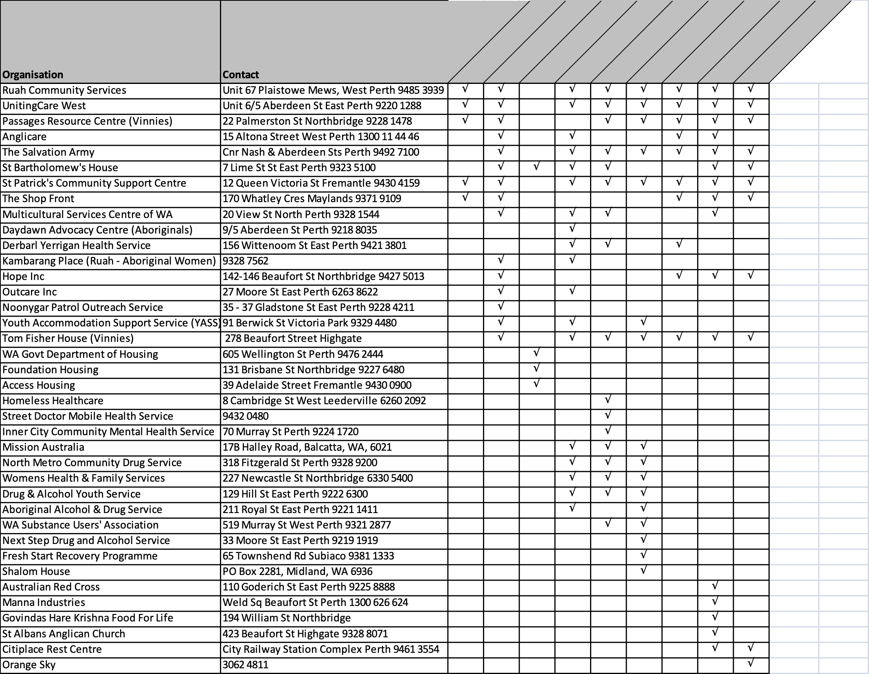
Homeless Agencies
Notes:
In general, major NGOs are well coordinated, but there are many small organisations providing ad hoc support.
Can we find/ develop a governing body that can control the total effort and eliminate waste and duplication

Slide 4
Context –
Homeless Hub
Assistant Governor Yvonne Hart pulled together the Zone 2 Clubs in 2017 to discuss an over-arching framework for the Zone’s Homelessness projects
This expanded to cover the District and became the Rotary “Homeless Hub” (HH)
Developed Terms of Reference
Prepared list of Homelessness Agencies
Initiated a survey of all Homelessness projects in the District
Currently meets monthly to discuss projects
Agreed that an early initiative should be to develop a strategy for Rotary’s approach to Homelessness in WA

Slide 5
HH Functions
Support projects across the District
  Provide a central source of information on homelessness for Club projects
    A list of Homeless Agencies and what they do
    A list of Rotary homelessness projects in the District
    A knowledge base of relevant Club member skills
  Internal education
  Help projects get the resources (funds, people etc) they need
  Help people find the right project for them
  Help Clubs band together on projects
  Help coordinate Club Projects
  Help new projects get off the ground
  Evaluate the impact of projects
Stay connected to the Homelessness world
  Maintain links with the Homelessness Agencies
  Form a Reference Group of expertise
Shape the project portfolio
  Maintain list of Homelessness projects
  Look for 'underdone' areas within the existing portfolio
  Look for new projects
  Maintain project calendar
  Evaluate the impact of projects
Advocate for homeless people
  WA community
  People of influence
  Politicians
Celebrate and publicise success
Intended that the Homeless Hub is independent across individual District Governors & Club Presidents

Slide 6
HH Governance
Members: representatives of all 9455 Clubs interested in Homelessness projects
The Hub has a Chair and Secretary, elected by the members for a 6 month term
Meetings
  Monthly project meetings
  Quarterly strategic meetings of all representatives
  Annual symposium?
Any Rotarian in District 9455 is entitled to attend meetings as an observer

Slide 7
Context –
Existing Rotary Homelessness Projects
2017 survey of District Homelessness projects:
  Of 48 Clubs surveyed, 46 responded (96%)
  27 Clubs run Homelessness projects(68%)
  47 individual projects identified
Findings:
  There is no overarching co-ordination of clubs in the District.
  There is no central source of information for Clubs to access
  Although aware of homelessness, clubs have little knowledge of activities and projects undertaken by other clubs
  There is plenty of scope for Clubs to collaborate on big projects that make a difference
  A lot of small individual financial gifts that pooled together could make a significant contribution
Recommendations
  Strategically Plan
    Continue the Homeless Hub concept and develop a broader, over-arching strategy across the District
    Identify and promote Rotary projects
  Encourage collaboration
    Eliminate duplication
    Focus on two or three projects
    Pool resources
Suggestions:
  Encourage clubs to pool their $ donations
  Support some major projects that were underway: Passages Resource Centre, Medical Respite Centre, Cans for Christmas, Socks in the City, Eye Contact exhibition

Slide 8
Homeless Hub
Proposed Vision & Core Purpose
Vision
  Harnessing the potential of Rotary to make a real difference to Homelessness in WA
Core purpose
  Have Rotary working as a coherent entity
  to bring its singular and unique capabilities to bear
  on the Homelessness issue
  Aligned to WA State and Agency Homelessness strategies

Slide 9
How can Rotary Add Value?
Assets:
  Credibility of the brand
  “Service above Self” ethos
  Enthusiasm & Determination
  Skills & Intelligence
  Networks & Influence
  Links with Schools
  Innovation - ability to pilot ideas and try them out
  Provision of tax deductibility for project-funding donors
Practical support:
  Funding
  Basic “arms and legs” support
  Skilled/ professional support – that NGOs find difficult or costly to source
Action: HH to develop a database of skills and trades that members are prepared to make available for projects

Slide 10
Where can Rotary add Value?
Community Education
Shift the perception of the community of WA to be supportive to people experiencing homelessness,
and to advocate for them
Prevention
Prevent homelessness happening in the first place
Homeless Support
Provide basic support to homeless people – eg food, clothing, health
Housing
Provide housing for the individual with appropriate support services
Transitional Services
Enable the individual to live independently
Agency Support
Help homeless agencies provide a good service
Areas underdone at present: Prevention, Community Education

Slide 11
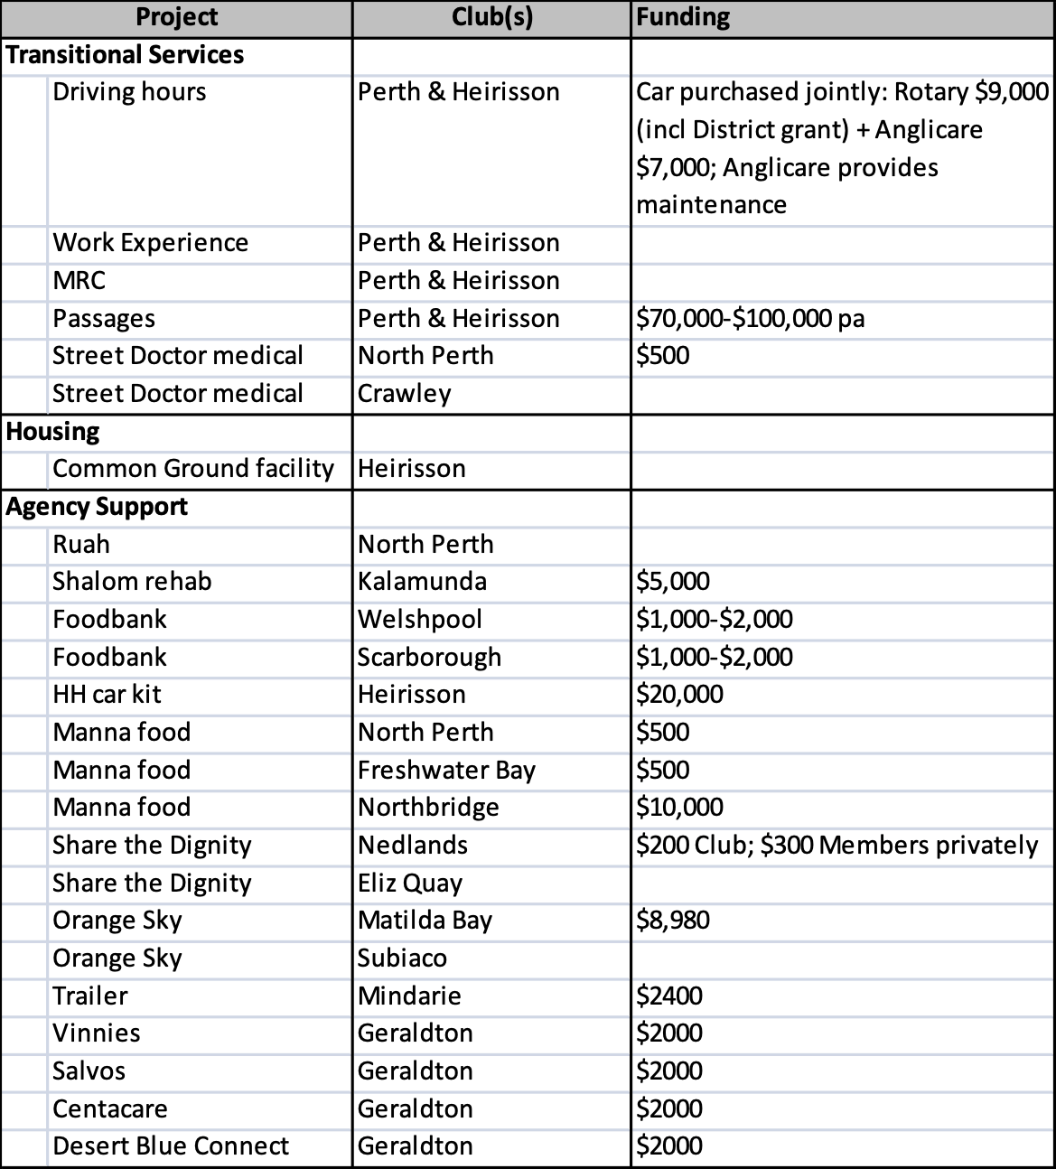
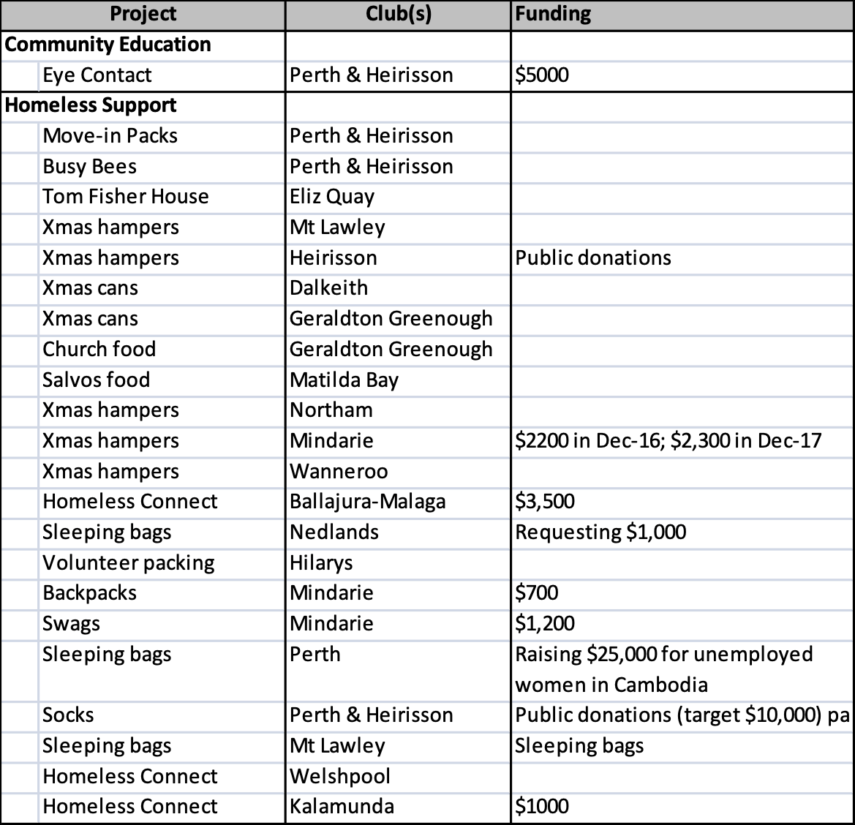
Existing Rotary Projects
If Rotary clubs are doing other projects not shown on the list, the Homeless Hub would like to know about them

Slide 12
Existing Rotary Projects
47 Homeless projects identified in District 9455
Of these:
  32 involve Funding ($200,000 in total but spread thinly)
  27 require basic Hands-on support
  5 require Skills beyond the basic
Also:
  17 contribute to Agency Support
  22 to Homeless Support
  6 to Transitional Services
  1 to Community Education
  1 to Housing
Managingthe Status Quo
Changing the Status Quo

Slide 13
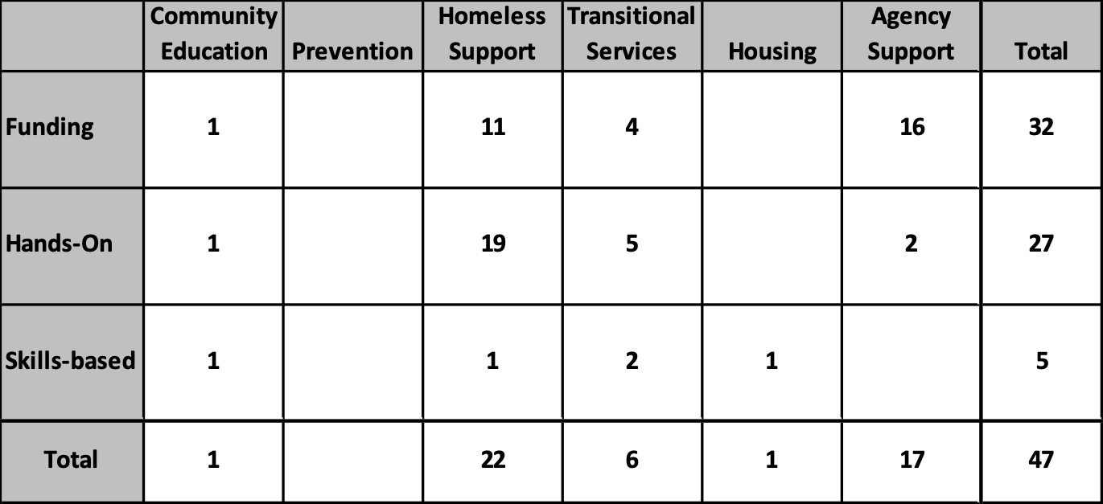
Existing Projects
Heavily weighted towards Homeless Support
Funding projects out-weigh Hands-On
  Funding Agency Support not always recognised

Slide 14
Where does Rotary Currently add Value?
Community Education (1)
Eye Contact
Homeless Support (22)
Backpacks, Busy Bees, Church food, Homeless Connect (3), Move-in Packs, Salvos food, Sleeping bags (4), Socks, Tom Fisher House, Volunteer packing, Xmas cans (2), Xmas hampers (5)
Transitional Services (6)
Driving hours, MRC, Passages, Street Doctor medical (2), Work Experience
Housing (1)
Common Ground
Prevention (0)
Agency Support (16)
Centacare, Desert Blue Connect, Foodbank (2), H.A.N.D, Homeless Healthcare, Manna (3), Orange Sky (2), Ruah, Salvos, Shalom House, Share the Dignity (2), Vinnies

Slide 15
Proposed Changes of Direction
Fix the problem, rather than manage it
  “We focus our efforts on ending homelessness, not just managing it” - WA Alliance to End Homelessness
More hands-on and skill usage for member involvement
Co-ordinate our funding efforts
Put the focus on some important projects that will make a real difference
Working with the WA Alliance to End Homelessness
Notes:
If we leave things as they are we will pour more money and effort into supporting the status quo and not changing it

Slide 16
Fixing the Problem
- Where we Need to Be
Community Education
Shift the perception of the community of WA to be supportive to people experiencing homelessness,
and to advocate for them
Prevention
Prevent homelessness happening in the first place
Housing
Provide housing for the individual with appropriate support services
Transitional Services
Enable the individual to live independently
Homeless Support
Provide support to homeless people – eg food, clothing, health
Agency Support
Help homeless agencies provide a good service
Making a real difference to Homelessness
– focus on Prevention, Housing, Transitional Services and Community Education

Slide 17
Where We Need to Be
To Fix the Problem:
  Using our strengths to make a difference:
  Community Education: changing the public’s attitude; advocating with politicians; Bringing the whole community and all schools along with Rotary homelessness efforts
  Prevention: Critically important – results here are worth way more than those elsewhere; Something Rotary can get really involved with, given our youth focus and links with schools
  Housing: Finding a permanent home for individuals
  Transitional Services: addressing what an individual needs to get back to being a useful member of society – health, self-reliance, employment
For our members:
  More “Hands-On” and “Skilled” projects
  Most NGOs struggle to provide marketing, strategic planning, financial planning needs.
  Contributing directly to help homeless people rather than just helping agencies
A shift from just giving money to agencies to getting personally involved with the issue
For Funding
  Better co-ordination of funds raised so we can put them to best use
A shift from giving small amounts to a myriad of causes to directing large amounts to key causes
A shift from just supporting homeless people
to bringing them back into society

Slide 18
Suggested Projects 1
Community Education:
  Surveying the community
  ‘Eye Contact’ has done a good job in raising community awareness. Take it into more local governments. Clubs can
  work with their LGAs to get them to host ‘Eye Contact’
Prevention:
  There is only a short ‘window of opportunity’ to prevent people that are newly homeless becoming ‘habitualised’ to that lifestyle.
  Bringing information sessions to linked schools
  Addressing family violence
  Supporting out-of-home care
  Identify ‘children at risk’ (work with Rotarians in Education).
  Intervention with children at risk
  Support and schooling for suspended children
  Support for ‘fathering projects’ – as in teaching boys to be good men. – alignment with ‘Path of Hope’
  Work in primary schools to support teaching of ethics and critical thinking
  Include homelessness components in ‘Constable Care’ activities
Action for HH: Advise all clubs about availability of ‘Eye Contact’
Action for Clubs: Advertise availability of ‘Eye Contact’ to their linked schools

Slide 19
Suggested Projects 2
Housing:
  Matching existing empty rentals to homeless people
  Researching and architecting new style housing for homeless people eg small houses, “common ground” apartments
    The ‘My Home’ project has been identified, placing small houses on land allocated by Department of Planning.
    Possibility of Rotary sponsoring construction of one suitable home as an example
  Rotary members can provide furnishings and logistical support
    This suggestion was included in the ‘Small Home’ Project submitted as a Centennial Project
  Need to encourage more government investment in social housing to address the lack of affordable housing
Transition:
  Companion volunteering – to help newly housed individuals adapt to independence
  Foyer Oxford driving supervision - we are desperate for drivers at Foyer Oxford to support young people to get their licence. Sixty per cent of all jobs require applicants to hold a driver’s licence.
Support:
  Engage further with Foodbank. We could organise up to 120 clubs across the country to collect food for distribution to homeless people. For example, a group of five clubs worked together collecting food.
Action: Graham to obtain details from Bill Richardson and Greg Hebble

Slide 20
Where we Need to be
- Projects
The District Portfolio should comprise:
3-4 big strategic scalable projects
  eg Passages, MRC, Eye Contact
  Typically these will be Clubs banding together using economies of scale to tackle a big issue, or make a big impact
A number of smaller ones which are calendarised
  eg Socks in the City, Foodbank Cans for Christmas, sleeping bags from Cambodia
Regular Club projects
  To sustain Club motivation & enthusiasm
  To link them to the agency they are supporting
  To support local involvement
  Clubs still able to develop and manage their own projects and free to join HH efforts voluntarily
We need a balance between short-term hands-on projects and longer-term big projects

Slide 21
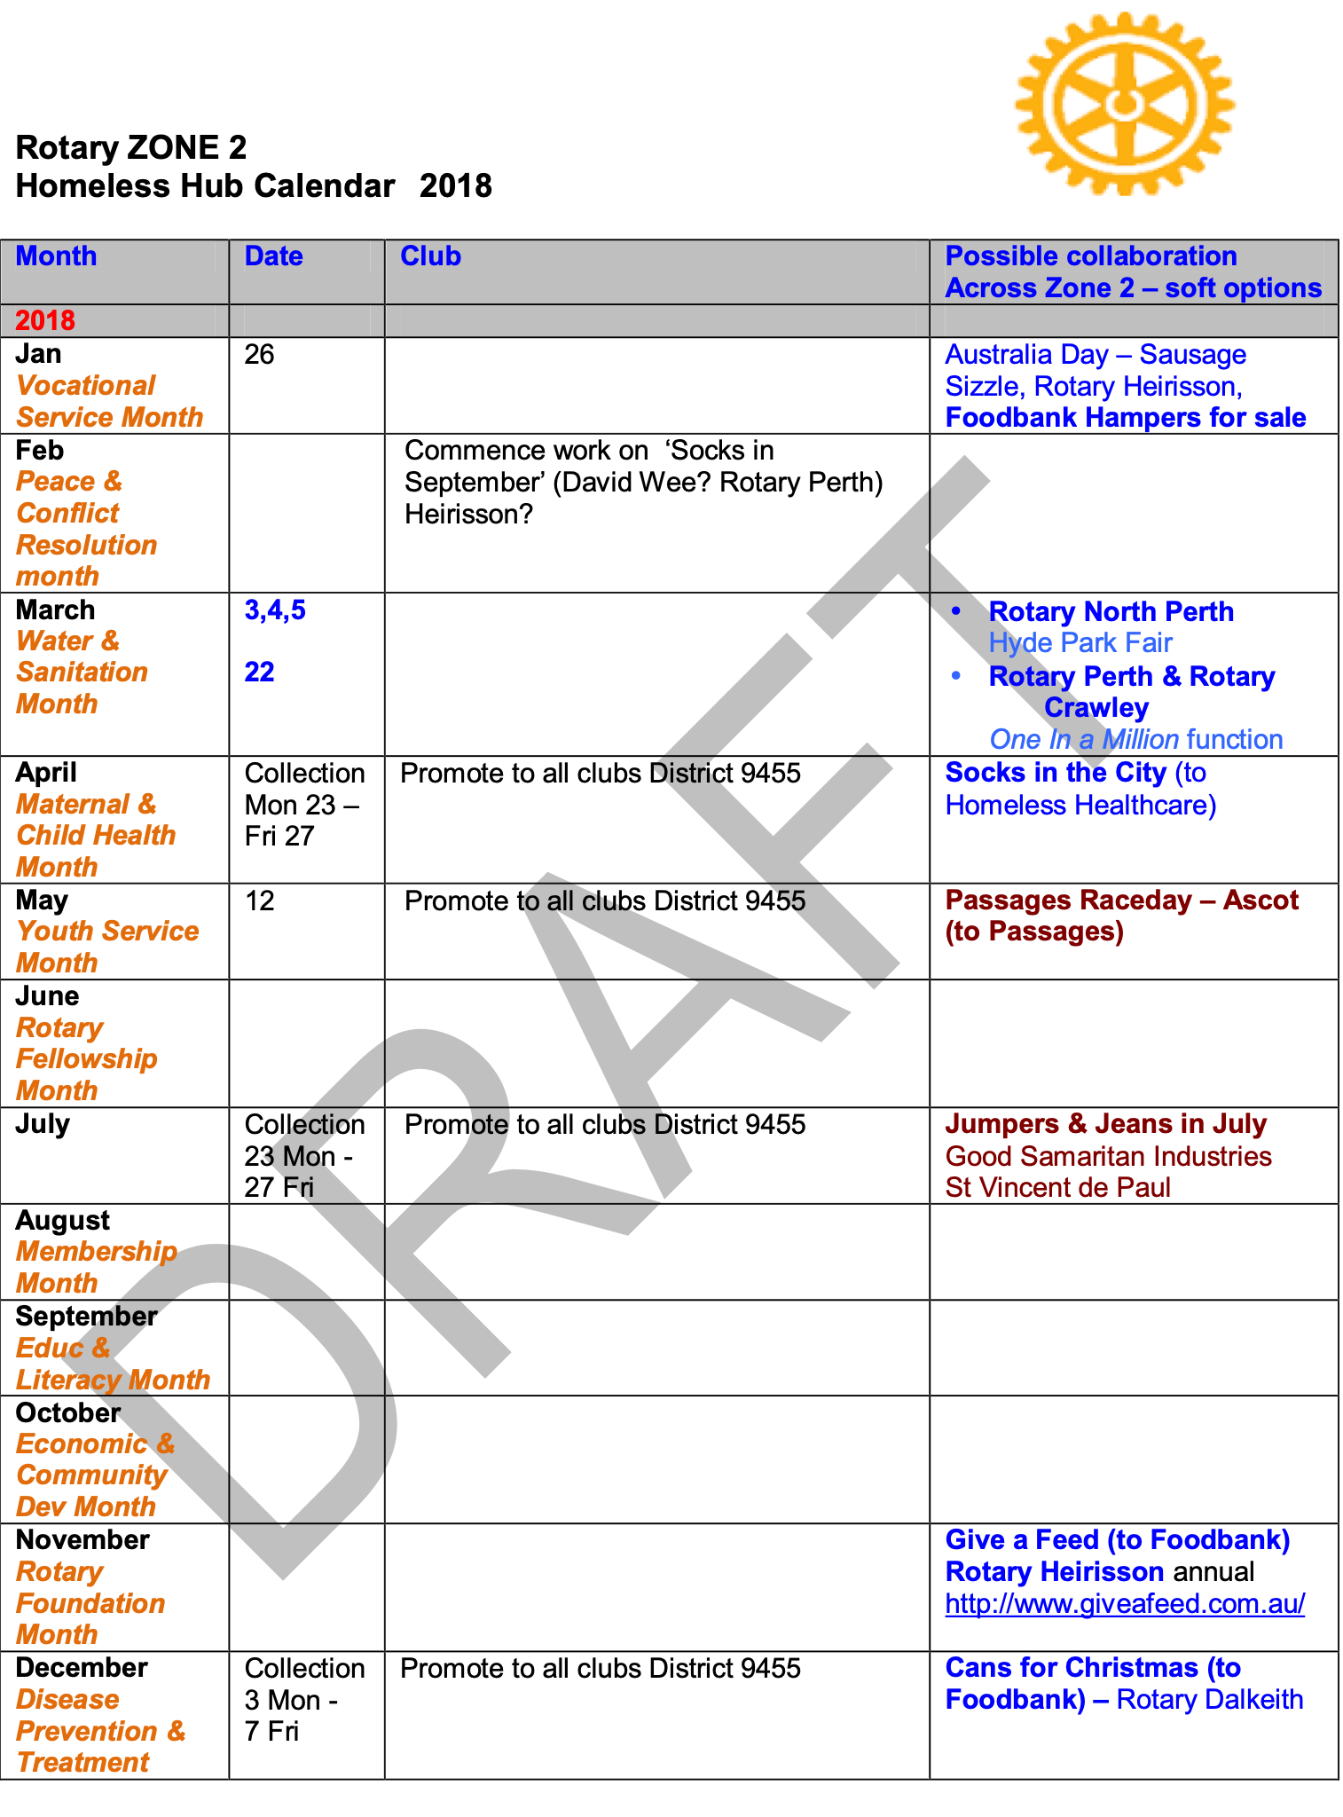
Draft HH
Project Diary
Diary itemising calendarised District projects

Slide 22
New Projects
Homeless Hub will look for new projects
  Where it will make a difference to Homelessness:
    Community Education
    Prevention
    Transition
    Housing
  Where it will motivate members:
    More hands-on and more skilled projects
  Where Rotary-level funding will make a real difference
And suggest them to Clubs that are keen to take on a homelessness project
  While maintaining a register of Club activities in homelessness
Clubs will look for new projects
  And suggest them to the Homeless Hub
Notes:
Skeleton of project up on the District Web Site, along with the rationale for it

Slide 23
Marketing
Rotary activities in homelessness need more publicity – to let people know what we do
Rotary clubs should make more use of Jess Karlsson (Marketing person for District 9455) in publishing their activities
To ensure Rotary gets recognition, Kalamunda RC has a standard agreement that they enforce when providing funds to other organisation, to ensure publicity of Rotary’s contribution
Suggest that clubs put their projects up through a ‘Rotary Showcase’ so we can create a unified story and critical mass
Suggest we badge projects as ‘A Rotary WA Project – an initiative of xxx club’
  In the case of big HH projects it can be ‘A Rotary WA Project – an initiative of xxx and xxx and xxx clubs’
Action for all Clubs
Action for HH– obtain copy of Agreement
Action for HH: Explore a Rotary Showcase

Slide 24
HH Communication
Intra- Rotary communication is poor with Clubs operating in silos and insufficient sharing of information. We need to do better.
We need a central dynamic information hub for information between meetings that is easy to use
  Possibility of using the Slack app (see https://slack.com/intl/en-au/)
Action for HH: discuss with Elizabeth Quay if Slack is the best option

Slide 25
Next Steps
General agreement with the strategy direction about ‘where we need to be’, but Clubs are keen to know how we get there
We need an Implementation Plan
  We need to visit places where they have developed solutions, make use of expert advice, and then build and implement an evidence-based model
  Refer to experiences in other countries where success is being achieved – e.g. Ireland, Finland, Canada (Medicine Hat).
Action for HH

